Slide 1

H2O
Members: Julian Mato-Hernandez, Quang Tran, Andrew Chacon
Notes:
Just say what our team name is and introduce ourselves

Slide 2
Problem Statement
Managers of large multi-unit properties are concerned that their security systems do not provide effective and comprehensive protection for their properties on a cost-effective basis.
Notes:
Focus on talking about property managers and their need for having a security system that is effective and reliable and overall cost effective

Slide 3
Solution Statement
H2O is a security system that utilizes an integrated Helium network that is effective, easy-to-use, and is reasonably priced.
Notes:
For this slide say that our security system uses the helium network that will make it effective easy to use and reasonably priced

Slide 4
Value Proposition
For Property Managers and Property Owners who want an affordable and reliable security system our helium network security system will provide reliable and affordable protection for their properties unlike ADT, Schlage and Amazon, and Ring
Notes:
For this slide We can simply read this statement as that is how a value proposition is used

Slide 5
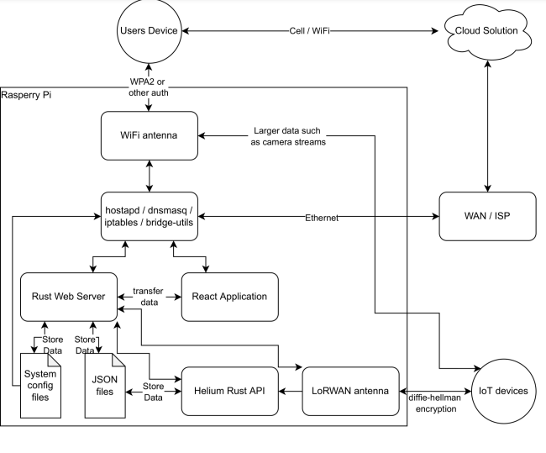
Notes:
For this slide do a brief overview of how our application configures and works together, but with a strong focus on how we will be implementing Rust into our application

